Slide 1
Workforce Training & Corporate Education

Slide 2
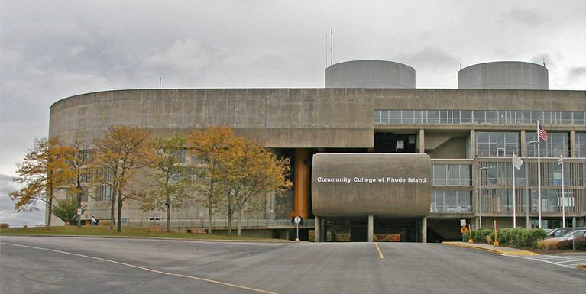
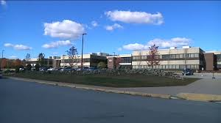
4 Campuses + 1
Warwick
Providence
Newport
Lincoln
Westerly

Slide 3
Center for Workforce and Community Education
Workforce Training & Corporate Education
CCRI's Center for Workforce Training & Corporate Education (WTCE) is a comprehensive resource addressing the training and workforce development needs of public, non-profit, and private sector organizations throughout Rhode Island.
Our clients include federal, state, and municipal governmental agencies, non-profit community and social services agencies, and companies, large and small, operating in such diverse industries as Maritime, Hospitality/Tourism, Consumer products, Financial services, Food & beverage, Healthcare, Manufacturing (including advanced and jewelry), and Retail, among others.

Slide 4
WTCE Services
Training can be customized to meet the specific needs of your organization.
Programs can be conducted at your facility or at a CCRI campus or a third party location.
Training programs can be delivered to groups in a classroom, one on one or using online and computer based formats.

Slide 5
What we do
Conduct company training needs assessment on site
Confirm the need for training
Determine training objectives with the desired results
Select how success will be measured using metrics
Meet with prospective instructors to discuss project, curriculum and training delivery plan
Submit proposal
Schedule program
Manage logistics
Ensure customer satisfaction of program and desired results
Program evaluations
Invoicing

Slide 6
Program Areas
Leadership (including ethics) Team Building Customer Service Computer Training Demographic and cultural diversity Financial Literacy Generational challenges in the workplace Performance Management Presentation skills Business writing Supervisory | Social media Office skills Business etiquette ESOL GED Safety Negotiation Communications Project Management Lean Manufacturing Continuous Improvement CNC Blue Print Reading Shop Math

Slide 7
Why Choose CCRI WTCE?
Specialize in designing and delivering custom programs to meet company’s individual needs.
Experience in delivering multiple training solutions; classroom, on site, on campus, third party site, web or computer based.
Five campuses statewide.
Broad range of subject matter experts; faculty, adjuncts for multiple types of programs.
Successfully delivered programs that positively impact a company’s operations and bottom line.
Competitive fee structure.
Successfully sourced training grants for companies.

Slide 8
Success Stories
Taco Comfort Solutions
MS Office training
Rhode Island Air National Guard
Business Writing
Arpin Moving
(Excel, Outlook)
Rhode Island State Police
Cisco Networking

Slide 9
John C. Freer Training Coordinator
John Freer is the Coordinator of Workforce Training and Corporate Education for the Community College of Rhode Island’s Center for Workforce and Community Education (CWCE). John’s focus is on developing customized training and corporate education solutions for public agencies, non-profits, and private sector organizations that have varied assessment and professional development needs. Programs can be delivered on-site, or on-campus, or online. See http://www.ccri.edu/forbusiness.
John has over twenty years of workforce training and education experience delivering programs to corporations, nonprofit agencies, post-secondary institutions and the military in Rhode Island and New England. Additionally, he founded a full service training consulting company that provided a variety of training programs in the Insurance, Finance, Heating Ventilation and Air Conditioning, Marine Trades, Culinary, Hospitality, Higher Education, Manufacturing and Medical Products.
He specializes in developing and managing customized, professional licensing and certificate programs. This includes instructors, administration, training grants, recruitment and placement of graduates. John is a past member of the Southern Connecticut American Society for Training and Development. John holds a B.S. in Business Administration from Eastern Connecticut State University.
CCRI
Liston Campus
One Hilton St.
Providence, RI 02905-2304
Web- www.ccri.edu/forbusiness
E-mail- jfreer@ccri.edu
Direct line- 401-455-6188
Main line- 401-455-6000

